Slide 1




Consumer Goods Insights Analysis

Slide 2
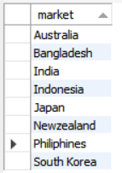
Provide the list of markets in which customer "Atliq Exclusive"
operates its business in the APAC region.
Request 1
Output:

Slide 3
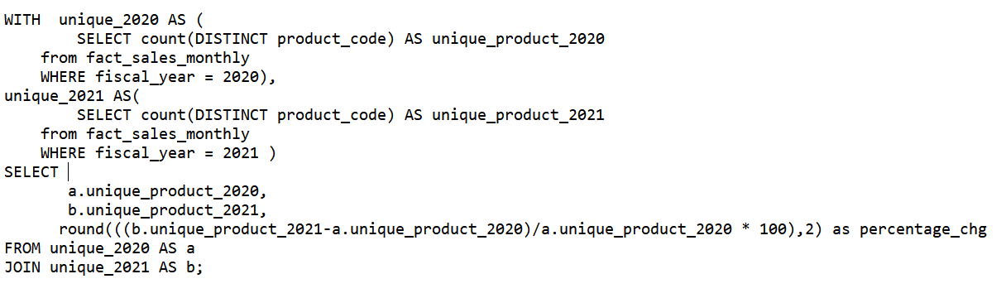
What is the percentage of unique product increase in 2021 vs. 2020? The final output contains these fields,
Query:
Request 2

Slide 4

OUTPUT
Insights of Request 2
Visualization
100%
136.33%

Slide 5
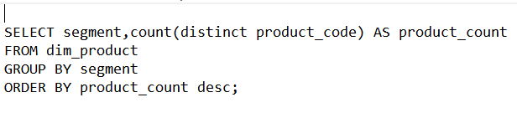
Provide a report with all the unique product counts for each segment and sort them in descending order of product counts.
Query:
Request 3

Slide 6
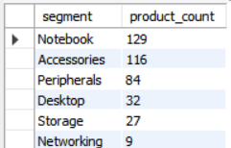
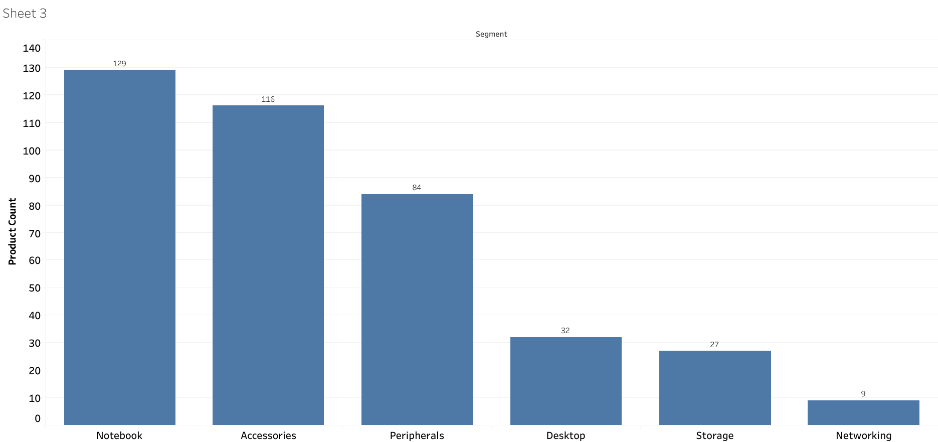
OUTPUT
Insights of Request 3
Visualization

Slide 7
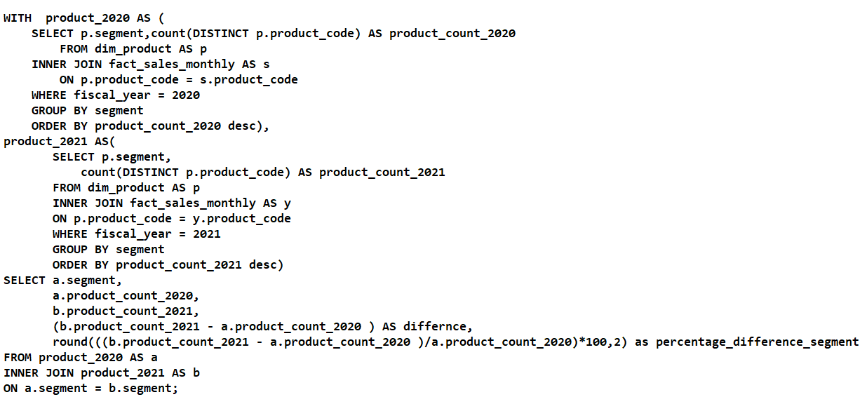
Which segment had the most increase in unique products in 2021 vs 2020?
Query:
Request 4

Slide 8
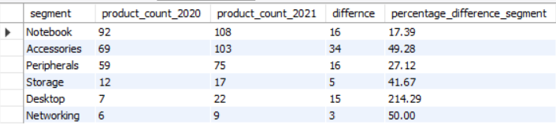
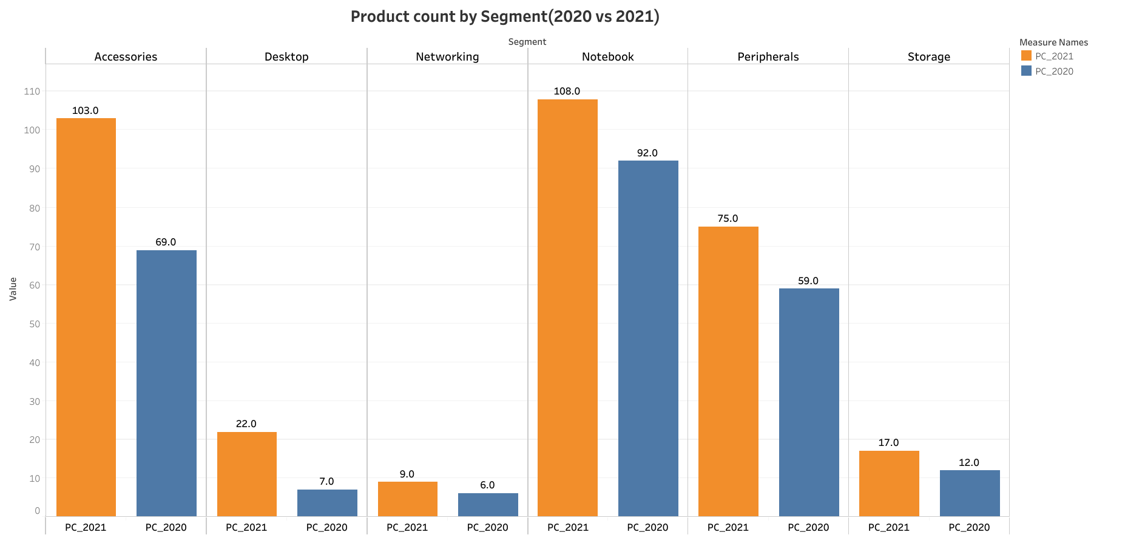
OUTPUT
Insights of Request 4
Visualization

Slide 9
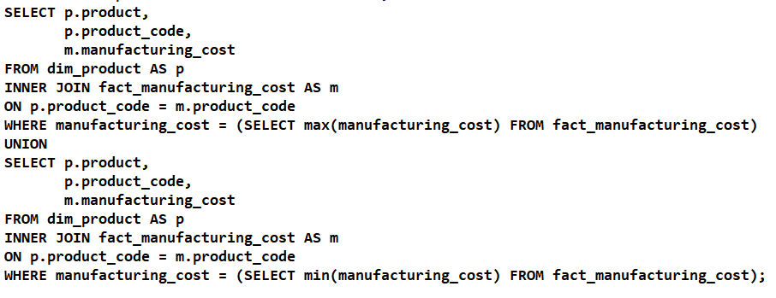
Get the products that have the highest and lowest manufacturing costs.
Query:
Request 5

Slide 10

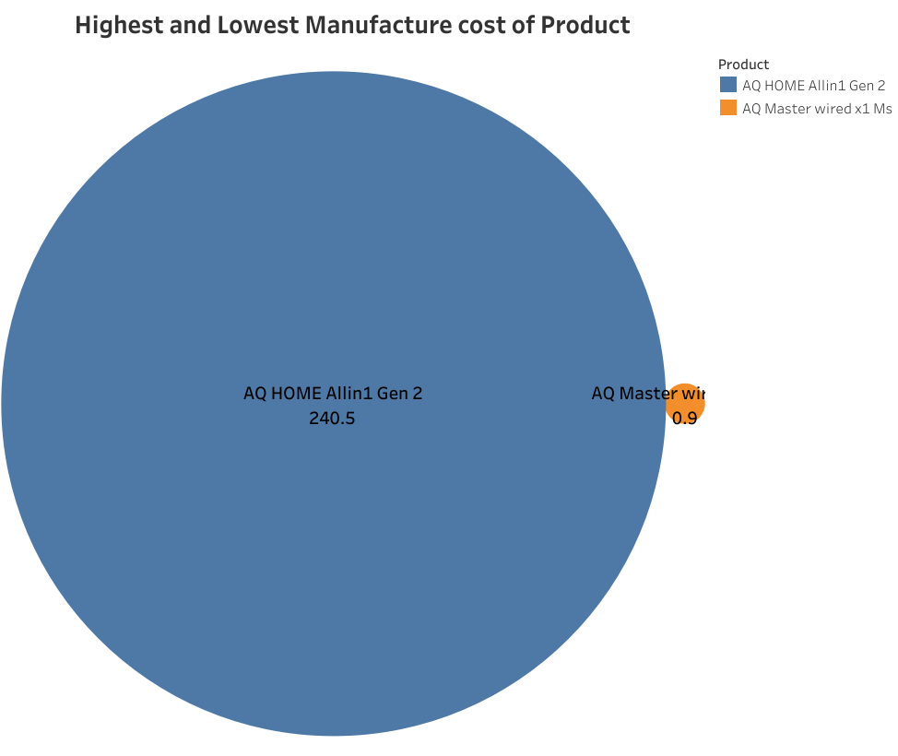
OUTPUT
Insights of Request 5
Visualization

Slide 11
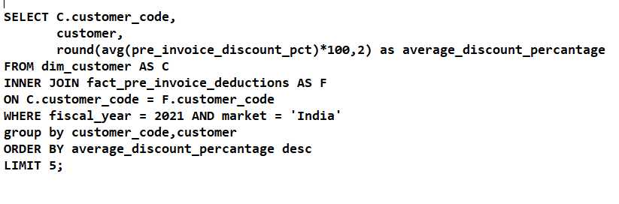
Generate a report which contains the top 5 customers who received an average high pre_invoice_discount_pct for the fiscal year 2021 and in the Indian market. .
Query:
Request 6

Slide 12
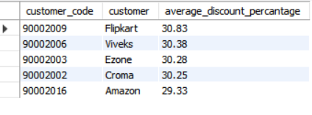
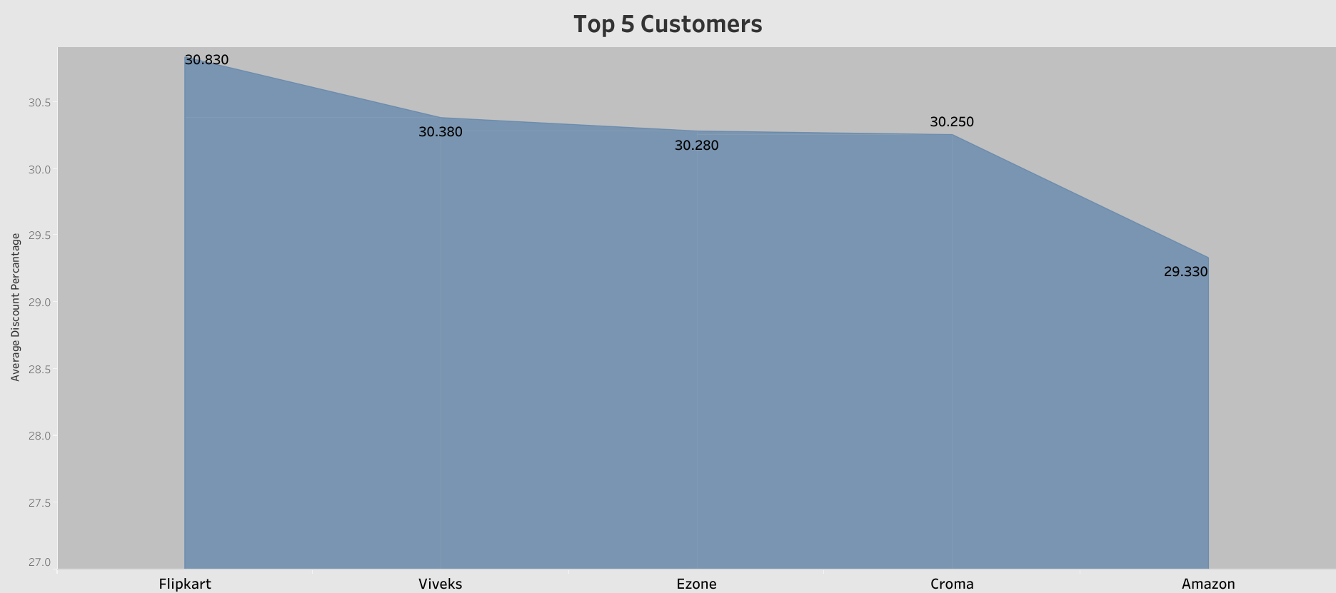
OUTPUT
Insights of Request 6
Visualization

Slide 13
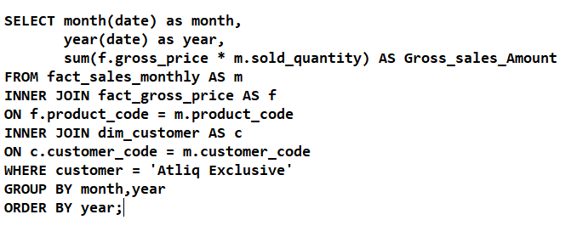
Get the complete report of the Gross sales amount for the customer “Atliq Exclusive” for each month. This analysis helps to get an idea of low and high-performing months and take strategic decisions..
Request 7
Query:

Slide 14
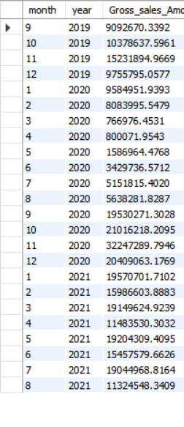
Output
v
Insights of Request 7

Slide 15
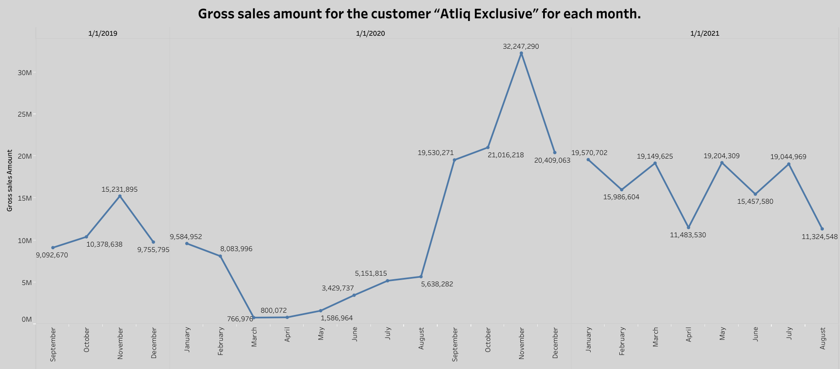
Visualization

Slide 16
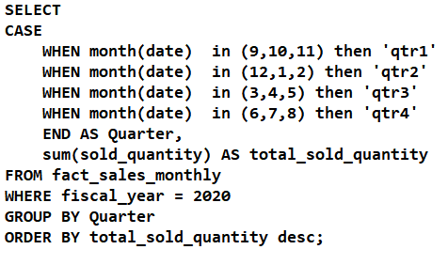
In which quarter of 2020, got the maximum total_sold_quantity.
Query:
Request 8

Slide 17
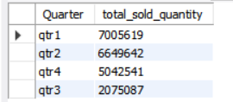
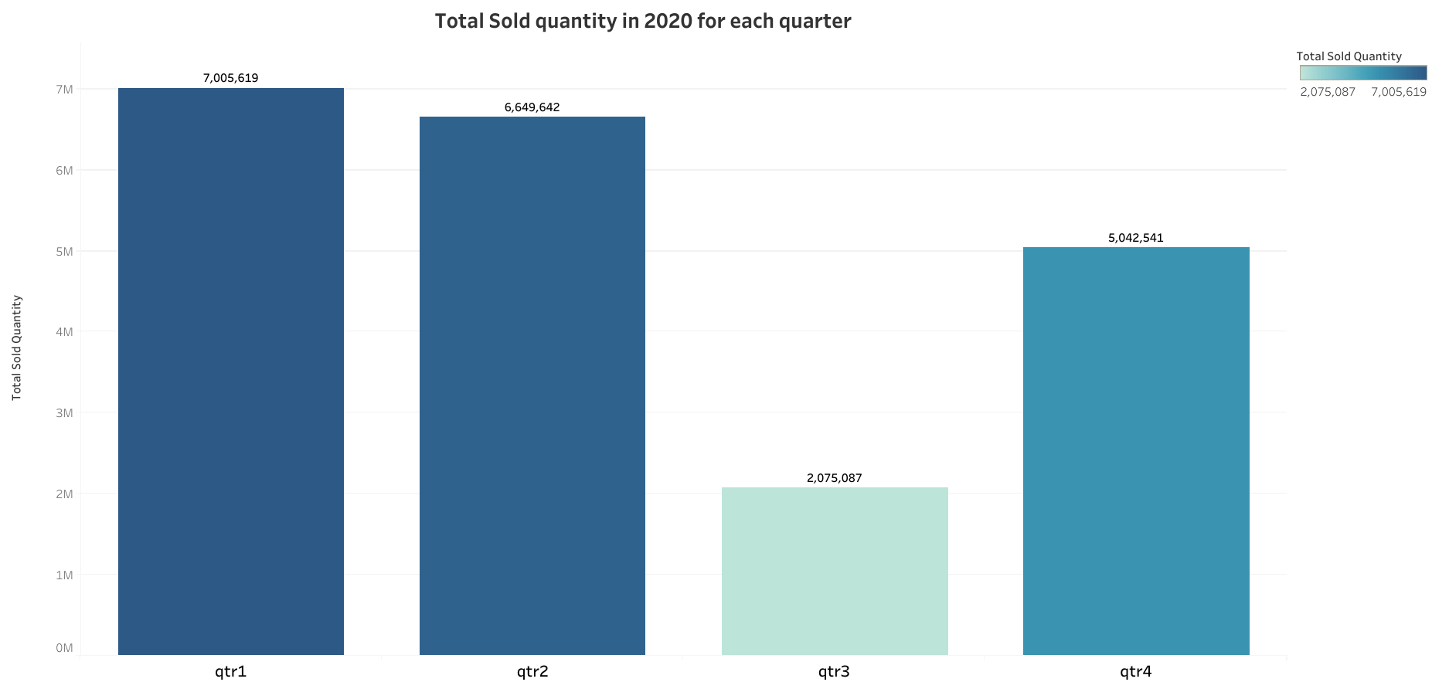
OUTPUT
Insights of Request 8
Visualization

Slide 18
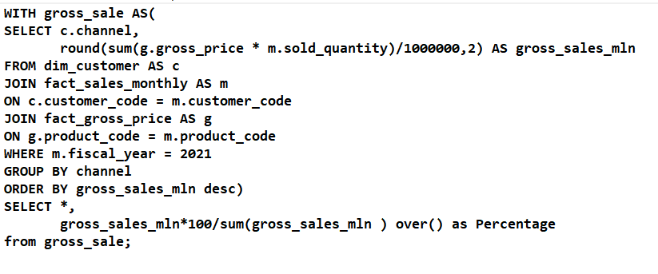
Which channel helped to bring more gross sales in the fiscal year 2021 and the percentage of contribution?.
Query:
Request 9

Slide 19
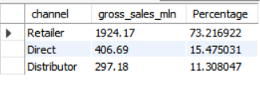
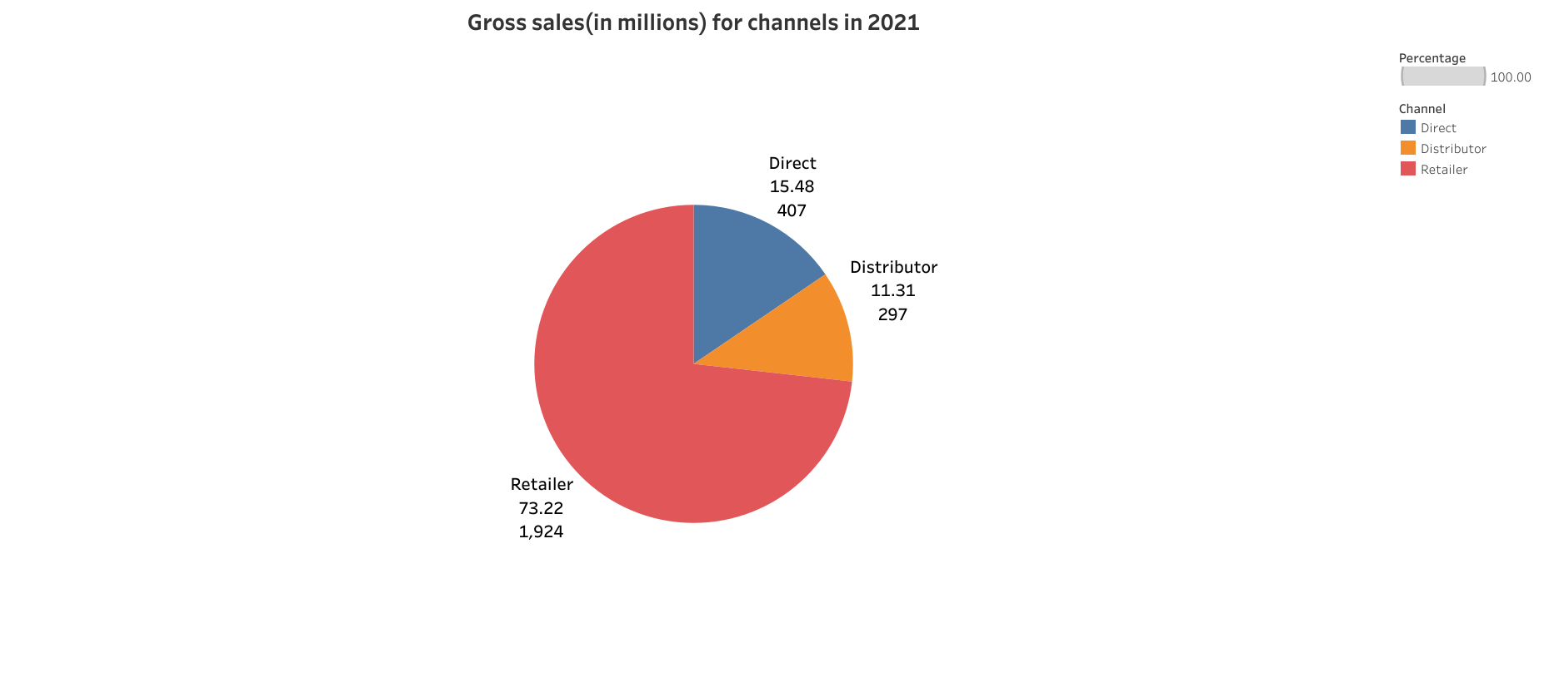
OUTPUT
Insights of Request 9
Visualization

Slide 20
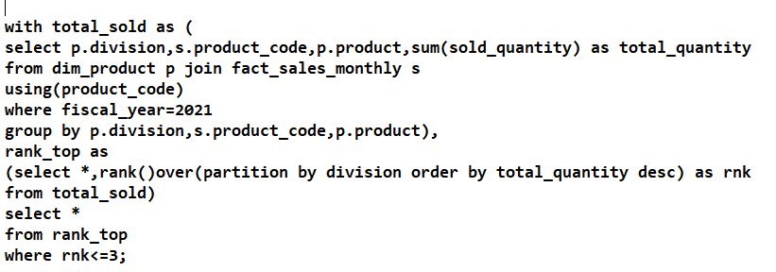
. Get the Top 3 products in each division that have a high total_sold_quantity in the fiscal_year 2021
Request 10
Query:

Slide 21
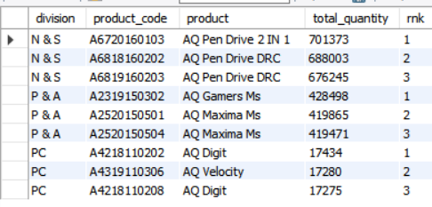
Output
v
Insights of Request 10

Slide 22
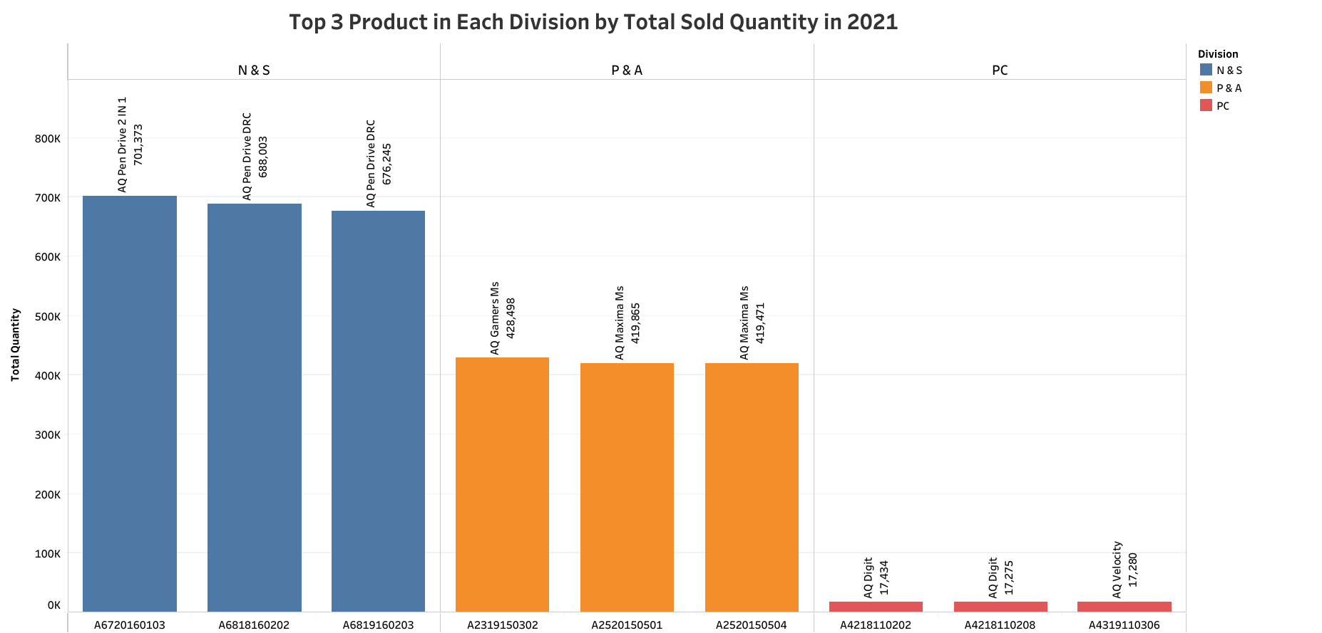
Visualization

Slide 23
SUMMARY FOR GIVEN REQUESTS
In Request 1 The list of markets in which customer "Atliq Exclusive" operates its business in the APAC region are
India,
Indonesia,
Japan,
Philiphines,
South Korea,
Australia,
New zealand,
Bangladesh.

Slide 24
Insights of request 2 on basis of Unique product are……..
Total 245 Unique Products their in 2020 and 334 Unique Products are their in 2021
No.of new Products added in 2021 are 89 , As per percentage 2021 36.33 percent more than year 2020
In request 3 we found the insights of unique product over different segments
We found that segment Notebook have highest count with 129 Unique product and Networking have low count with 9 unique products
Peripherals and Desktop are at settle at middle with the unique product count 84 and 32

Slide 25
Insighs of request 4 on basis of Segments over unique product in 2020 and 2021 years are……..
We found the Accessories have highest difference in Unique Product Code compare to previous year with the difference of 34
Networking have the lowest difference compare to previous year
In request 5 we found out the Highest and Lowest Manufacturing of Products
AQ HOME Allin 1 Gen 2 Product have the highest Manufacturing cost value 240.54 and Product code ‘A6120110206’
AQ Master Wired x 1 MS Product have the lowest Manufacturing cost value 0.89 and Product code ‘A2118150101’

Slide 26
Insights of request 6 on basis of Customer who received highest average Pre invoice discount percentage in 2021
Filpkart have received the highest average pre invoice discount of 0.3803 , Followed by Viveks,Ezone,Crome and Amazon
In request 7 we found Gross sales amount of Atliq Exclisive Customer over different Months
Highest Gross sales are occures in the Month of November in 2020 and gross sales amount value 32.24 Millions
Lowest Gross sales are occures in the Month of March in 2020 and gross sales amount value 0.76 Millions

Slide 27
Insights of request 8 on the Quarter which have highest Total sold Quantity in year 2020……..
Quarter 1 have the highest total sold quantity value 7.01 Millions
Quarter 3 have the lowest total sold quantity value 2.07 Million
In request 9 we found out Channel which have highest gross sales in the fiscal year 2021
Retailers have the highest gross sales percentage of 73.22%
Direct channel have gross sales percentage of 15.48%
Distributor channel have gross sales percentage of 11.30%

Slide 28
We have to drawn the insights of Top 3 Products in each division that have highest sold quantity in the fiscal year 2021 in request 10
The Product AQ Pen Drive 2 IN 1 Ranks Top in N & S Division with value 0.70 Millions and the Product Code ‘A6720160103’
The Product AQ Gamers Ms Ranks Top in P & A Division with value 0.42 Millions and the Product Code ‘A2319150302’
The Product AQ Digit Ranks Top in PC Division with value 0.017 Millions and the Product Code ‘A4218110202’

Slide 29
Thank you
Happy Analyzing

